Slide 1
Agile Metrics and Reporting
Robin Surland
Notes:
1

Slide 2
AGENDA
Objectives & Goals
Business Value
Running Tested Features
Inspect and Adapt
Data Needed
Estimate Size – Derive Duration
Burndown Charts (Log)
Jira Reports
Velocity (Trend)
Capability

Slide 3
Agile Metrics
Predictability
Value
Quality
Productivity
3. Customer Surveys
2. On Time Delivery
1. Velocity
4. # Features or Value Delivered
6. Issue Defect Cost
5. Running Tested Features

Slide 4
OBJECTIVES & GOALS
Project Objectives
Detail Specifics
Include Qualitative and Quantitative Measurements
Seek Consensus With the Team
Create a Reasonable Approach in Obtaining Those Objectives
Operate in a Methodical Timeframe
Example: We will design 15 training courses that meet organizational development guidelines by June 30 with a budget of $483,000. We will include courses on supervision, communication, performance appraisals, and creating an optimistic workplace.
Notes:
SETTING MEASURABLE PROJECT OBJECTIVES
~ By Dr. Keith Mathis
Examine ten projects at random, and you will see some of the worst written objectives. Project objectives are often hard to track, vague, and lacking in depth. In project objectives, people need details to help know where they are in the process, and data helps them make informed decisions. I like to recommend "DISCO" when forming objectives. "DISCO" can be spelled out to point us in the proper direction for creating project objectives and tracking their progress.
D - Detail Specifics
Give as much information as possible and make these objectives very specific. Far too many objectives have been set, which are very grey in nature and lack data to help team members understand all specifics.
I - Include Qualitative and Quantitative Measurements
Objectives must be measured. When you look at an objective, you must ask, Can we measure this? If not, it needs to be rewritten so that it can be measured and tracked for successful completion. The only way to do this is to make sure qualitative and quantitative components are set.
Qualitative measurements measure a project based on quality standards, quality indicators, or quality characteristics. Defect ratio, break down ratio, and improvement needs are all to be considered. Each of these can be prioritised and broken down into a specific tracking mechanism to follow and monitor.
Quantitative measurements measure the project based on numerical indicators. Some of the most common quantitative measurements are time, budget, production, work hours, process time, and development progress. Quantitative measurements normally include the need to set a series of benchmarks as a starting point to begin tracking.
S - Seek Consensus With the Team
Making sure the team agrees with the measurement is very important. Sometimes objectives are set at the beginning of the project, and they are very loose. When the team sets a standard of measurement, it will usually be detailed and understandable. It is important because the team needs to be on the same page during planning. They must agree that these standards are the best possible measurements considering the project.
C - Create a Reasonable Approach in Obtaining Those Objectives
The approach for reaching objectives is very important. Unless the approach is understood by the entire team and supported, there will be conflict in the team's processes. Conflict means you will have people going in different directions and using various methods.
O - Operate in a Methodical Timeframe
Setting up a timeline and follow it. This timeline must make sense and be publicized to the entire team. You must constantly focus on maintaining clarity.
An example of a great DISCO objective is, We will design 15 training courses that meet organizational development guidelines by June 30 with a budget of $483,000. We will include courses on supervision, communication, performance appraisals, and creating an optimistic workplace. DISCO objectives can be very successful in pushing the project forward and bridging the gap for communication. However, good objectives will never write themselves, nor will they track themselves.

Slide 5
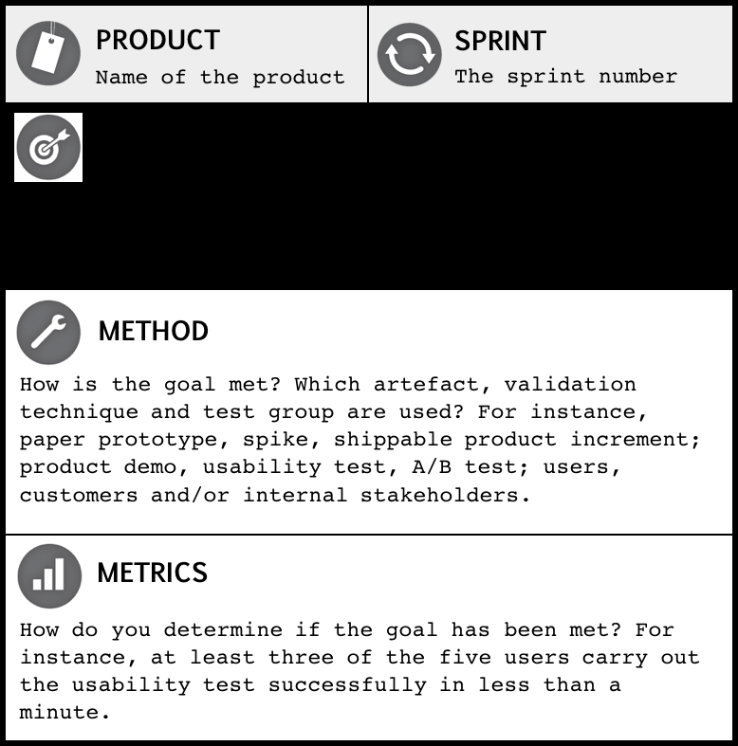
OBJECTIVES & GOALS
Sprint Goals
A sprint goal describes the purpose of a sprint. It provides a shared objective, and states why it’s worthwhile undertaking the sprint.
Examples:
Learn about the right user interaction for the registration feature.
Make the reporting feature available to the users.
Source: http://www.romanpichler.com
Notes:
Sprint Goal Benefits
Supports Prioritization
Creates Focus and Facilitates Teamwork
Helps Obtain Relevant Feedback
Makes it Easier to Analyze the Feedback
Supports Stakeholder Communication

Slide 6
BUSINESS VALUE
What is business value?
What you can implement successfully and sustainably.
What your customers want and will use/buy (even if they don’t know it yet).
What your team is excited about creating.
What you can implement.
What you can “sell”.
What you are passionate about.

Slide 7

BUSINESS VALUE
Sources of Business Value
Market Value
Sell More
Charge More
Reduce Cost
Risk Reduction
Develop or Refine Hypotheses
Prove Technical Assumptions
Capability Building
Do Something We Couldn’t Do Before
Reduce Need for Low-Value Work

Slide 8
RUNNING TESTED FEATURES
Shorn of all technical details, running tested features may be described as a measure to determine and quantify how much progress of real business value has been accomplished. In terms of measuring productivity, RTF is indisputably an easy and a healthy method and Agile team should be able to consistently deliver.
The chief advantage is that this metric offers adequate time to react to project-centric problems before they adversely affect the project.

Slide 9

INSPECT AND ADAPT
Transparency
Transparency allows the deeper use of systemic thinking tools, like the five whys.
Transparency facilitates team learning.
Transparency enables positive management involvement and self-curtails adverse management interference.

Slide 10

INSPECT AND ADAPT
Be deliberate about inspection.
Make feedback immediate.
Seek feedback on three levels.
Product
Process
Code / Technical
Find as many feedback loops as possible.
Don’t forget to adapt!
Notes:
What feedback loops do you use? What are your tricks to get the most out of the inspect and adapt approach?

Slide 11

DATA NEEDED
Scope total project points over time
Velocity the rate at which goods or services are produced output/time
Define Team Capacity application & business knowledge + technical knowledge & experience
Productivity Factor points(8)/hours
Customer Value quantified

Slide 12
ESTIMATE SIZE – DERIVE DURATION
Point estimates are a way to size work packages.
These estimations are independent of how or who.
Used to determine productivity and velocity.
Desired Features
Estimate Size
Derive Duration
Create
Schedule
Determine Velocity
(Total Story Points / Velocity) + 1 = Number of Sprints +/- Standard Deviation

Slide 13
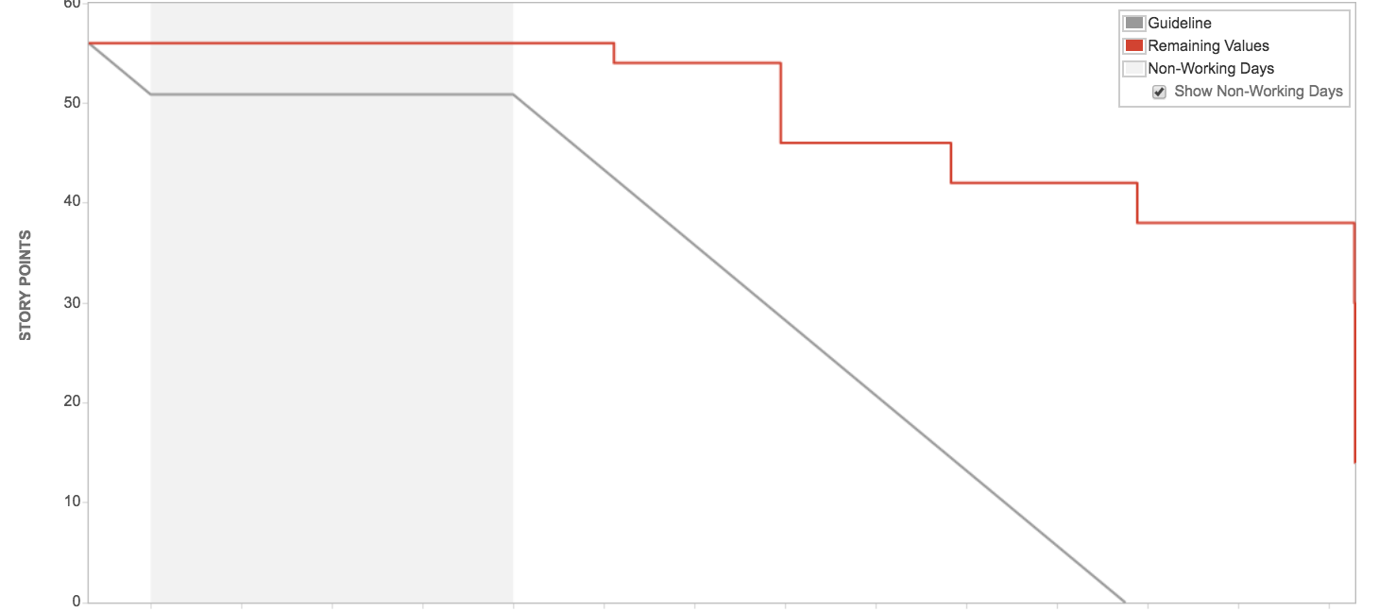
BURNDOWN CHARTS

Slide 14
WHY VELOCITY
Velocity = Average number of story points a team gets done in a sprint.
Predictability
What can be done by a specific date?
When can X be completed?
How much value can a team deliver over time?
Accuracy: Developing a consistent velocity allows for more accurate release and sprint planning.

Slide 15
DETERMINE VELOCITY
Velocity is the key metric in Scrum.
Product Backlog
Sprint
Backlog
8
5
3
5
5
8
The team pulls their desired number of stories into the current sprint.
3
5
3

Slide 16
DETERMINE VELOCITY
Velocity is the key metric in Scrum.
Product Backlog
Sprint
Backlog
Sprint
Backlog
5
8
8
8
Estimated velocity = 21 points.
Actual velocity = 13 points.
5
5
3
3
3
8
5
5
5
Beginning of Sprint
End of Sprint
3
5
5

Slide 17

APPLY STANDARD DEVIATION
Obtaining the Range
Work out the Mean (the simple average of the numbers)
Then for each number, subtract the Mean and square the result.
Then work out the mean of those squared differences.
Take the square root of that and we are done!
STDEV.P

Slide 18

FORECASTING FORMULAS
Derive Schedule
Determine Velocity
Apply Standard Deviation to obtain the range.
(Total Story Points / Velocity) + 1 = Number of Sprints +/- Standard Deviation

Slide 19

FORECASTING FORMULAS
Estimate Cost
Number of Sprints
Number of Resources * % Allocation
OSU “Average Labor Burden” of $100,000) / Number of Sprints Per Year
= Estimated Labor Costs

Slide 20
CAPABILITY
Ideal team member would score a 10.
Team Member | Application & Business Knowledge | Technical Knowledge & Experience
Ronnie | 5 | 2
Jeni | 3 | 3
Dante | 2 | 4
Leisha | 1 | 2
Team Score: | 5.5
Application & Business Knowledge
0 – No experience with the application and none (or minimal) related business knowledge.
1 – Has some familiarity with the application.
2 – Has worked on the application previously.
3 – Has through knowledge of the application and///or business.
4 – Thorough knowledge of the app and/or business and associated apps.
5 – Wrote the app and have worked on it frequently over several years.
Technical Knowledge & Experience
0 – New to the technology.
1 – Has had training in the technology.
2 – Has done at least a couple of projects with the technology (a couple months experience).
3 – One year’s experience with technology.
4 – Multiple year’s experience/lead in the technology.
5 – Has written a book on, defines standards, or teaches the technology.
Source: Fidelity National Information Services (FIS)

